Slide 1


Welcome to Our Presentation
“Your Ticket to Cinematic Bliss”

Slide 2

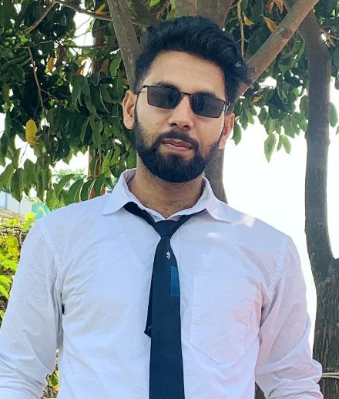
Meet our team
Md. Habibur Rahaman
Mehedi Hasan Saim
Naimul Haque Shuvo
Monowar Afsar
221-15-5174
221-15-4844
221-15-4941
221-15-5366

Slide 3
Introduction
Welcome to our innovative movie ticket booking platform, where convenience meets entertainment. Our website is your one-stop destination for hassle-free movie ticket reservations

Slide 4

Is There Any other app available with same features??

Slide 5

Let’s Take a Look at Our Project…….

Slide 6
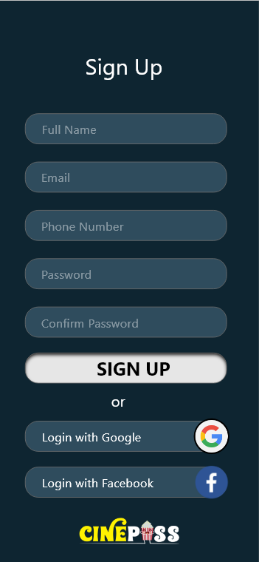
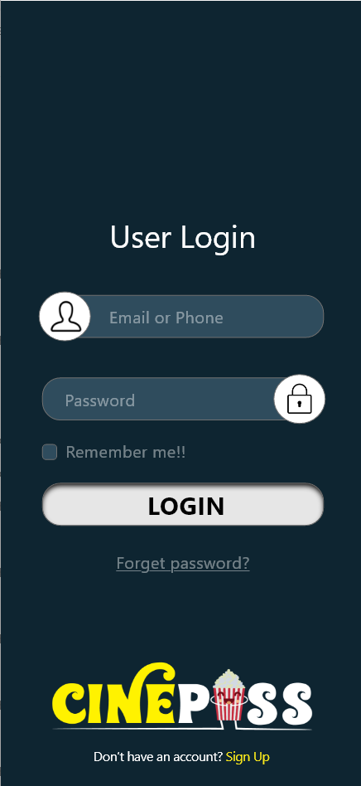
Sign UP
&
Login

Slide 7
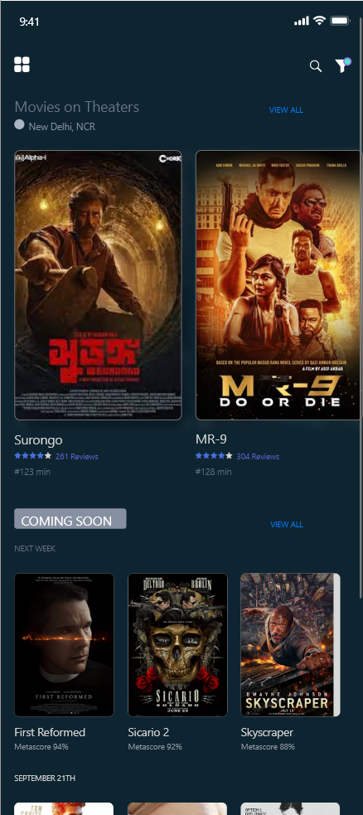
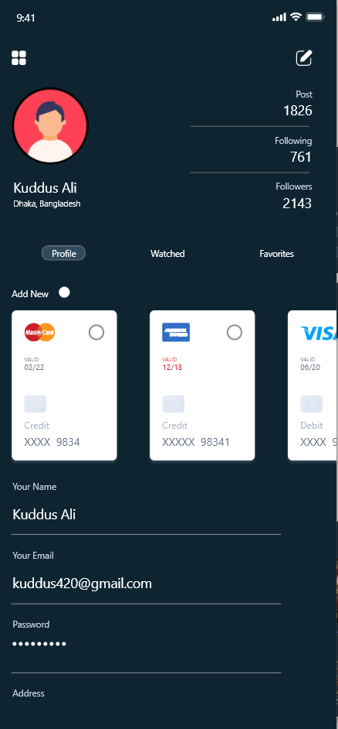
Home &
Profile

Slide 8
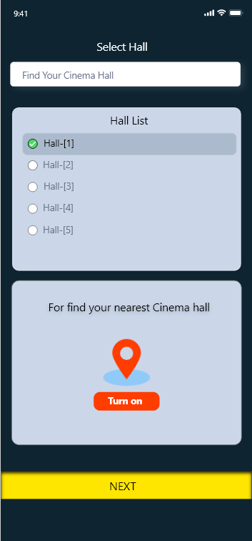
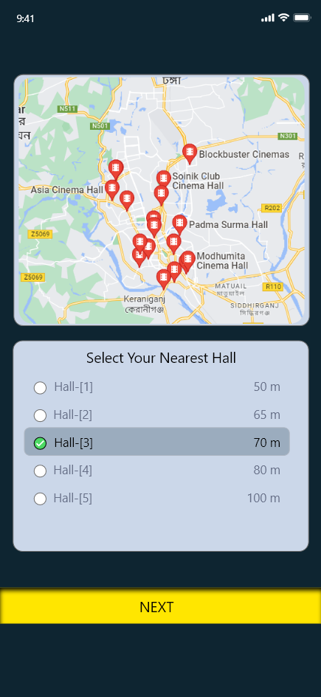

Hall Selection

Slide 9
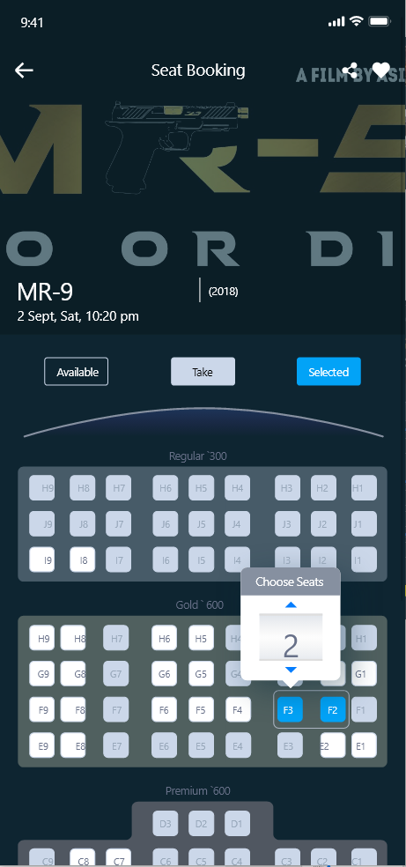
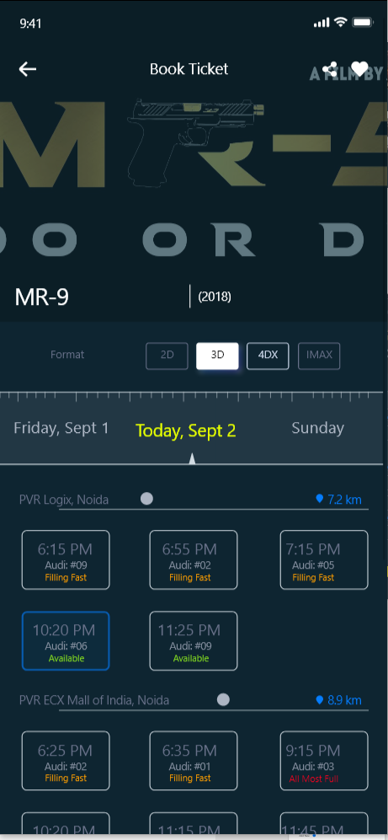
Time & Seat Selection

Slide 10
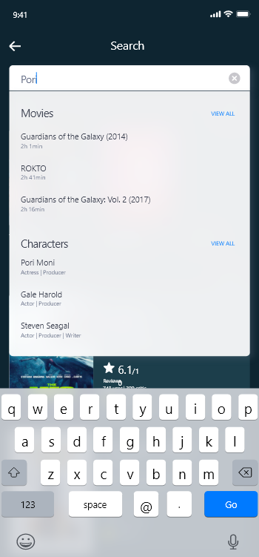
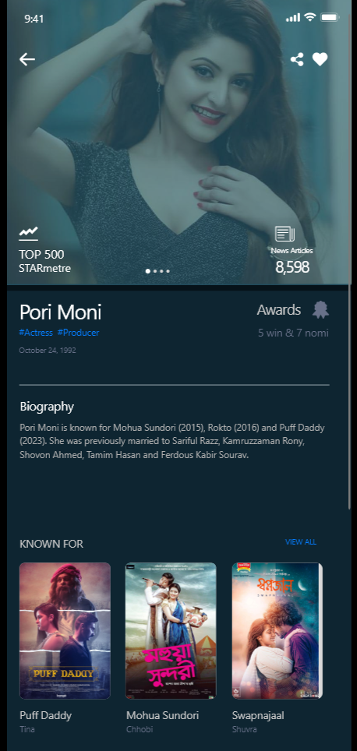

Searching

Slide 11
Some Process to build the Project
Web Developing
APIs for Movie Data
Real-time Update
Booking Workflow
Payment Gateway Integration
Security Measures
Scalability

Slide 12

Thank you

